Slide 1
COVID-19 STATUS USING DATA VISUALIZATION
TEAM MEMBERS:
AARTHI B.K(vtu11259)
J SUBASH (vtu11654)

Slide 2

ABSTRACT:
The outbreak of Coronavirus disease 2019 (COVID-19), caused by severe acute respiratory syndrome (SARS) coronavirus 2 (SARS-CoV-2), has thus far killed over 3lakhs of people and infected over millions all over the world, resulting in catastrophe for humans. In response to the rapidly increasing number of publications on the emerging disease, this covid-19 status project attempts to provide a timely and comprehensive review of the swiftly developing research subject novel corona virus. Using Data visualization and machine learning techniques, we have developed a concept of providing live status of affected regions along with data’s such as mortality rate, affected cases, no of cured in a particular country.

Slide 3
PROBLEM STATEMENT:
The world is facing one of the biggest public health, social, and economic crises it has seen in generations. Rapid development of coronavirus disease into a pandemic has called for people to acquire and apply health information, and adapt their behaviour at a fast pace.
Though there are many predictions related to the live status of corona affected regions, still there is some lagging in providing exact state of the affected regions

Slide 4


OBJECTIVE:
The main objective of this project is to
To collect and provide correct database
To detect the affected regions with greater accuracy
To provide user access for the collected information

Slide 5

Slide Title
PROPOSED SYSTEM:
In order to provide a proper database for the citizens regarding covid-19, we came up with an idea of data visualization technique. Data visualization, where the databases are collected. Once this process is executed, we will be getting the status of various regions as output.
This project is an effort to analyze the cumulative data of confirmed, deaths, and recovered cases over time. In this project, the main focus is to analyze the spread trend of this virus all over the world.
Make Effective Presentations
Using Awesome Backgrounds
Engage your Audience
Capture Audience Attention

Slide 6
LIBRARY FILES:
Pandas - for dataset handling
Numpy - Support for Pandas and calculations
Matplotlib - for visualization (Platting graphs)
pycountry_convert - Library for getting continent name
folium - Library for Map
keras - Prediction Models
plotly - for interactive plots
SOFTWARES:
Data visualization using machine learning is executed for this project using python.

Slide 7
MACHINE LEARNING:
Machine Learning is a form of AI that enables a system to learn from date rather than through explicit programming. A machine learning model is the output generated when you train your machine learning algorithm with data. After training, when you provide a model with an input, you will be given in output. It can be used in real time to learn from data. The improvement in accuracy are a result of the training process and automation that are part of machine learning.
DATA VISUALIZATION:
Data visualization is the graphical representation of information and data. By using visual elements like charts, graphs and maps. These tools provide an accessible way to see and understand trends, outliers and patterns in data. Data visualization allows to make the complex simple, the abstract tangible and the invisible data visible with great illustrations. In the world of big data visualization tools and technologies are essential to analyze massive amounts of information and make date – driven decisions.

Slide 8
METHODOLOGY:
The databases of various countries all over the world regarding corona affected is collected.
The collected databases are classified based on mortality rate, no. of affected, no. of recovered, no. of active cases and no. of deaths
In the world map created using data visualization the databases are integrated using python and the result is displayed.
DATABASE SOURCE:
The daily databases are collected from World Health Organization.
COVID-19 tracker by John Hopkins University

Slide 9
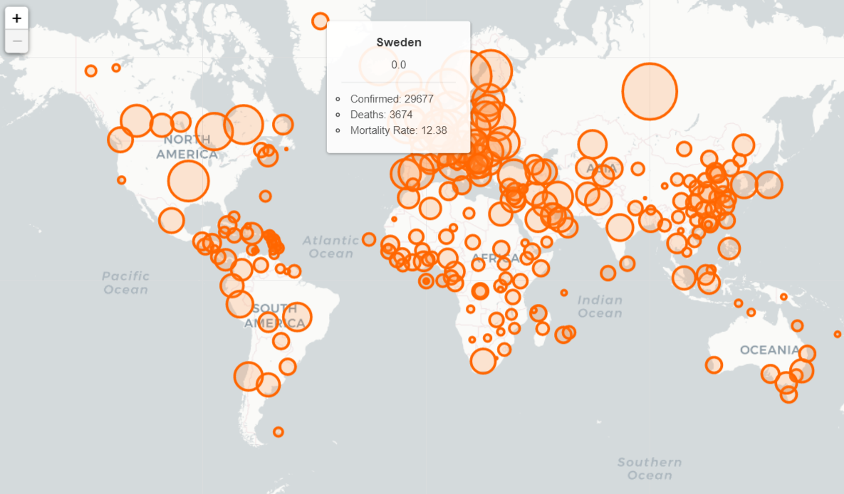
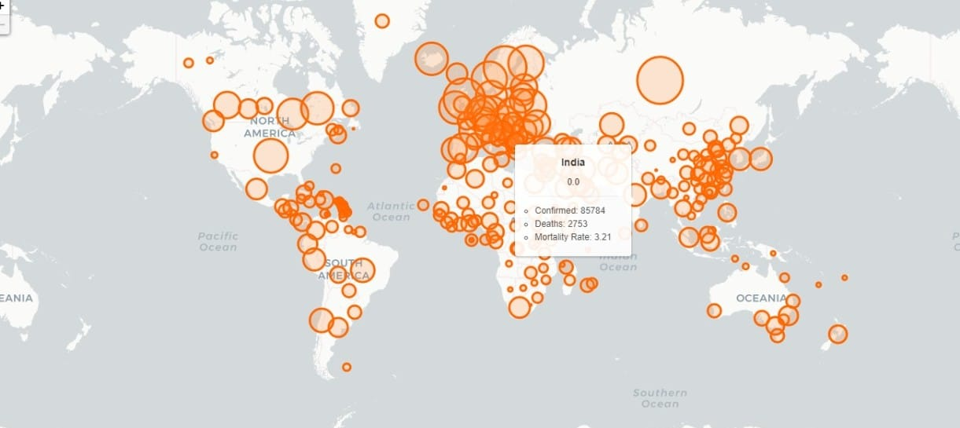
OUTPUT

Slide 10
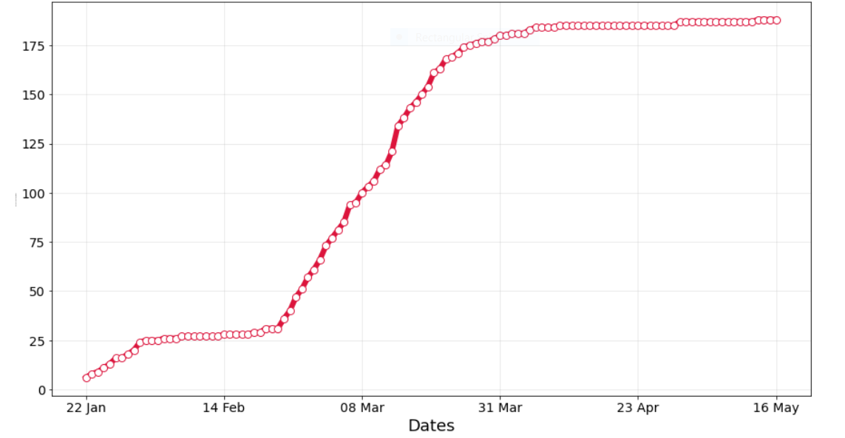
Gradual increase in corona affected

Slide 11
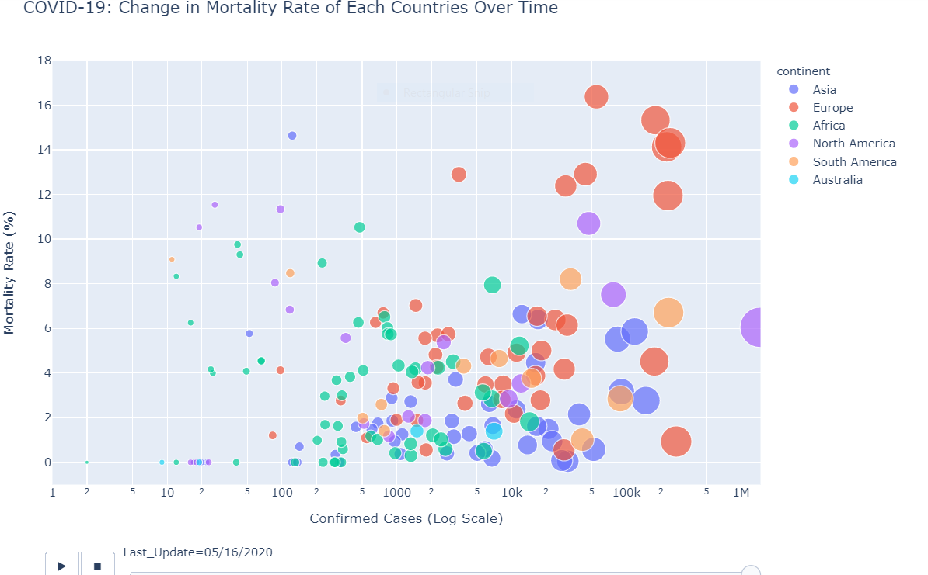

Slide 12
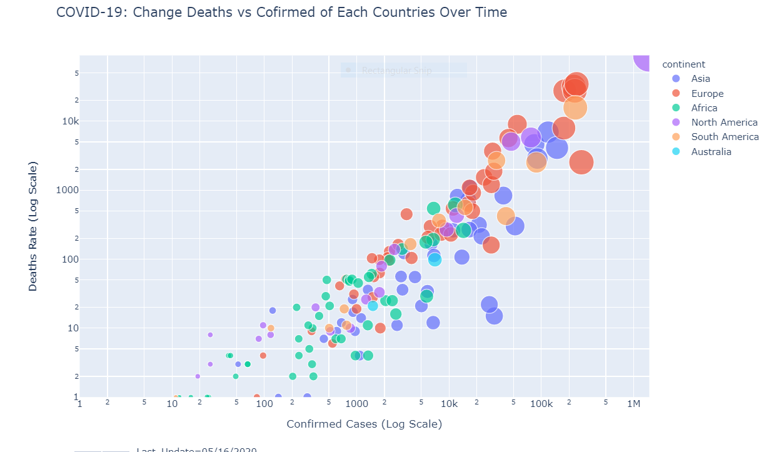

Slide 13

ADVANTAGES:
It helps people all over the world to stay updated regarding Covid-19
It records the databases collected over a period of time.
The web page helps user for easy access for the Covid information.
Webpage for covid-19 information

Slide 14
CONCLUSION:
From this project we conclude that the datas regarding the status of corona was provided successfully with help of data visualization which will be a greater help for citizens to know their neighborhood in a better way

Slide 15
REFERENCES:
World Health Organization. Clinical management of severe
acute respiratory infection (SARI) when COVID-19 disease
is suspected. 2020 [internet publication].
CDC COVID-19 Response Team. Severe outcomes among
patients with coronavirus disease 2019 (COVID-19): United
States, February 12 - March 16, 2020. MMWR Morb Mortal
Wkly Rep. 2020 Mar 27;69(12):343-6.
Tomlins J, Hamilton F, Gunning S, et al. Clinical features of 95 sequential
hospitalised patients with novel coronavirus 2019 disease (COVID-19), the first UK cohort. J Infect. 2020 Apr 27 [Epub ahead of print]

Slide 16
THANK YOU

